Slide 1
Design and Analysis of Algorithms
Lecture 1:
Logistics, introduction, and multiplication!

Slide 2
Algorithms are fundamental
The
Algorithmic
Lens
Operating Systems
Machine learning (CS
Cryptography
Compilers
Networking
Computational Biology

Slide 3
Algorithms are useful
As inputs get bigger and bigger, having good algorithms becomes more and more important!

Slide 4
Algorithms are fun!
Algorithm design is both an art and a science.
Many surprises!
Many exciting research questions!

Slide 5
What’s going on?
Course goals/overview
Logistics

Slide 6
Course goals
The design and analysis of algorithms
They go hand-in-hand
In this course you will:
Learn to think analytically about algorithms
Flesh out an “algorithmic toolkit”
Learn to communicate clearly about algorithms

Slide 7
Roadmap
More detailed schedule on the website!
5 lectures
2 lectures
Randomized Algs
EthiCS 1
On MIDTERM
Asymptotic Analysis
Data structures
Sorting
Today
Divide and conquer
Recurrences
Dynamic Programming
Greedy Algs
EthiCS 2
Graphs!
Longest, Shortest, Max and Min…
On FINAL
8 lectures
The
Future!
2 lectures

Slide 8

Our guiding questions:
Does it work?
Is it fast?
Can I do better?

Slide 9
Our internal monologue…
What exactly do we mean by better? And what about that corner case? Shouldn’t we be zero-indexing?
Dude, this is just like that other time. If you do the thing and the stuff like you did then, it’ll totally work real fast!
Does it work?
Is it fast?
Can I do better?
Plucky the
Pedantic Penguin
Lucky the
Lackadaisical Lemur
Detail-oriented
Precise
Rigorous
Big-picture
Intuitive
Hand-wavey
Both sides are necessary!

Slide 10
Aside: the bigger picture
Does it work?
Is it fast?
Can I do better?
Should it work?
Should it be fast?
We want to reduce crime.
It would be more “efficient” to put cameras in everyone’s homes/cars/etc.
We want advertisements to reach to the people to whom they are most relevant.
It would be more “efficient” to make everyone’s private data public.
We want to design algorithms, that work well, on average, in the population.
It would be more “efficient” to focus on the majority population.

Slide 11
IPython Notebooks
Lectures will occasionally be accompanied by IPython notebooks (but not homework)
For the next lecture, the pre-lecture exercise is to get started with Jupyter Notebooks and with Python.
See the course website for details.
The goal is to make the algorithms (and their runtimes) more tangible.

Slide 12
References
Algorithms Illuminated, Vols 1, 2, and 3 by Tim Roughgarden
Additional resources at algorithmsilluminated.org
We may also refer to the following (optional) books:
”CLRS”: Introduction to Algorithms by Cormen, Leiserson, Rivest, and Stein. Available FOR FREE ONLINE through the Stanford library.
“Algorithm Design” by Kleinberg and Tardos

Slide 13
Homework
Weekly assignments, posted Sunday by 11:59pm, due the next Sunday 11:59pm.
First homework will be posted this Wednesday
There are 9 total (no HW the week before midterm)
HW1, HW2, HW3: solo submissions
HW4, HW5, HW6, HW7, HW8,HW9: solo/pair submissions
We only accept typed submissions. Handwritten submissions lose points on homework 1, and receive ZERO points from homework 2 onwards.

Slide 14
How to get the most out of homework
HW has two parts: exercises and problems.
Do the exercises on your own.
Try the problems on your own before discussing it with classmates.

Slide 15
Grading
Homework 20%
Lowest homework score will be dropped. Each of the 8 remaining homeworks equally weighted.
Midterm 20%
Weekly Exam (Oral) || (Paper) 10%
Presentation 10%
Final 40%

Slide 16

A note on course policies
Course policies are listed on the website.
Read them and adhere to them.
That’s all I’m going to say about course policies (except for a couple of slides on collaboration and the honor code)

Slide 17
Collaboration
We encourage collaboration on homework (but strongly recommend you do exercises on your own)
Valid and invalid modes of collaboration are detailed on the course website.
Briefly, you can exchange ideas with classmates but must write up solutions on your own (except for pair submissions from HW4 onwards).
For pair submissions (HW4 onwards), each person must understand and contribute to the solution for each individual problem.
You must cite all collaborators, as well as all sources used (outside of course materials).

Slide 18
Honor code
Updated two years ago: “In all cases, it is not permissible for students to enter exam questions into any software, apps, or websites. Accessing resources that directly explain how to answer questions from the actual assignment or exam is a violation of the Honor Code.”
Course policy for homework: “In all cases, it is not permissible for students to enter homework questions into any software, apps, or websites. Accessing resources that directly explain how to answer questions from the actual assignment or exam is a violation of course policy.”

Slide 19
Bug bounty!
We hope all PSETs and slides will be bug-free.
Howover, we sometmes maek typos.
If you find a typo (that affects understanding*) on slides, IPython notebooks, Section material or PSETs:
Let us know! (Post on Ed or tell a CA).
The first person to catch a serious bug might get a good citizenship bonus point.
Good citizenship points: we might consider bumping letter grades for people who end up near boundaries and have lots of good citizenship points.
Bug Bounty Hunter
*So, typos lke thees onse don’t count, although please point those out too. Typos like 2 + 2 = 5 do count, as does pointing out that we omitted some crucial information.

Slide 20
Feedback!
We will have high-resolution feedback throughout the course (subset of you randomly asked each week, starting week 2).
Please help us improve the course!

Slide 21
The big questions
Who are we?
Professor, TA’s, students?
Why are we here?
Why learn about algorithms?
What is going on?
What is this course about?
Logistics?
Can we multiply integers?
And can we do it quickly?

Slide 22
Today’s goals
Course goals
Think analytically about algorithms
Flesh out an “algorithmic toolkit”
Learn to communicate clearly about algorithms
Karatsuba Integer Multiplication
Algorithmic Technique:
Divide and conquer
Algorithmic Analysis tool:
Intro to asymptotic analysis

Slide 23
Let’s start at the beginning

Slide 24
Etymology of “Algorithm”
Al-Khwarizmi was a 9th-century scholar, born in present-day Uzbekistan, who studied and worked in Baghdad during the Abbassid Caliphate.
Among many other contributions in mathematics, astronomy, and geography, he wrote a book about how to multiply with Arabic numerals.
His ideas came to Europe in the 12th century.
Dixit algorizmi
(so says Al-Khwarizmi)
Originally, “Algorisme” [old French] referred to just the Arabic number system, but eventually it came to mean “Algorithm” as we know today.
Notes:
So in some sense, the grade-school multiplication algorithm is the ultimate “algorithm!”

Slide 25
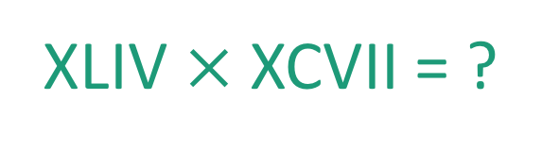
This was kind of a big deal
44
97
XLIV $×$XCVII = ?
x

Slide 26
Integer Multiplication
44
97
x

Slide 27
Integer Multiplication
1234567895931413
4563823520395533
x

Slide 28

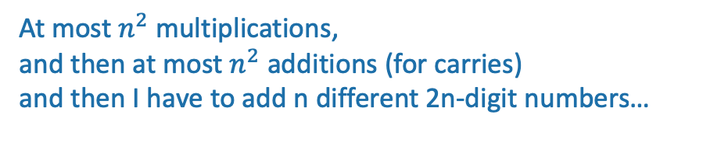
Integer Multiplication
n
1233925720752752384623764283568364918374523856298
4562323582342395285623467235019130750135350013753
x
How fast is the grade-school multiplication algorithm?
???
(How many one-digit operations?)
About $n^{2}$one-digit operations
Think-pair-share Terrapins
At most $n^{2}$multiplications,
and then at most $n^{2}$ additions (for carries)
and then I have to add n different 2n-digit numbers…
Plucky the Pedantic Penguin

Slide 29
Big-Oh Notation
We say that Grade-School Multiplication
“runs in time O(n²)”
Formal definition coming Wednesday!
Informally, big-Oh notation tells us how the running time scales with the size of the input.

Slide 30
Implemented in Python, on a laptop
highly non-optimized
The runtime “scales like” n²
Looks like it’s roughly
T_{laptop}(n) = 0.0063 n² – 0.5 n + 12.7 ms...

Slide 31

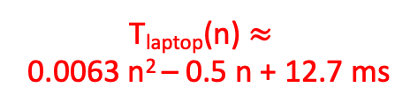
Implemented by hand
The runtime still “scales like” n²
Some other quadratic function of n
T_{laptop}(n) $≈$
0.0063 n² – 0.5 n + 12.7 ms
Notes:
It totally takes me less than 30 seconds to multiply two 500-digit numbers…

Slide 32

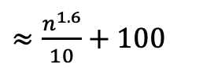
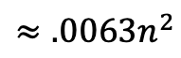
Why is big-Oh notation meaningful?
Wizard’s algorithm
$≈\frac{n^{1.6}}{10}+100$
$$≈.0063n^{2}$$
Notes:
It totally takes me less than 30 seconds to multiply two 500-digit numbers…

Slide 33
Let n get bigger…
$≈\frac{n^{1.6}}{10}+100$
Time (ms)
$$≈.0063n^{2}$$
Wizard’s algorithm

Slide 34
Take-away
An algorithm that runs in time O(n^{1.6}) is “better” than an algorithm that runs in time O(n²).
So the question is…

Slide 35
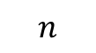
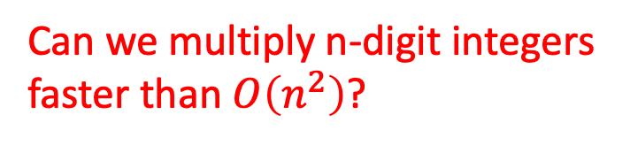
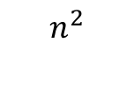
Can we do better?
Can we multiply n-digit integers faster than $O\left(n^{2}\right)$?
$$n^{2}$$
$$n$$

Slide 36
Let’s dig into our algorithmic toolkit…

Slide 37
Divide and conquer
Break problem up into smaller (easier) sub-problems
Big problem
Smaller problem
Smaller problem
Yet smaller problem
Yet smaller problem
Yet smaller problem
Yet smaller problem

Slide 38
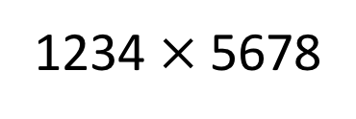
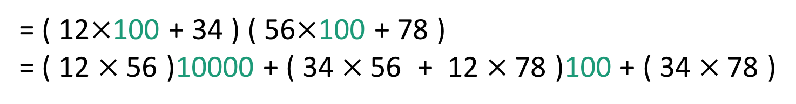
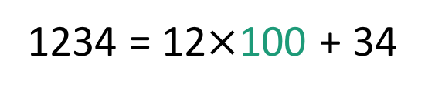
Divide and conquer for multiplication
Break up an integer:
1234 = 12$×$100 + 34
1234$×$5678
= ( 12$×$100 + 34 ) ( 56$×$100 + 78 )
= ( 12$×$56 )10000 + ( 34$×$56 + 12$×$78 )100 + ( 34$×$78 )
1
2
3
4
One 4-digit multiply
Four 2-digit multiplies

Slide 39
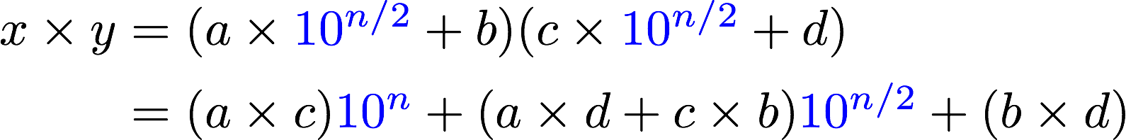
More generally
Suppose n is even
Break up an n-digit integer:
1
2
3
4
One n-digit multiply
Four (n/2)-digit multiplies

Slide 40
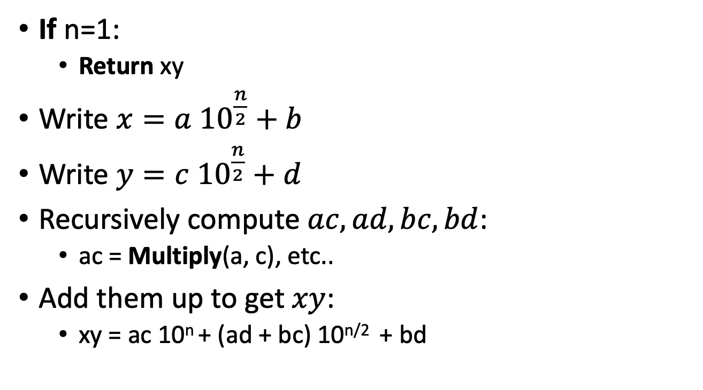
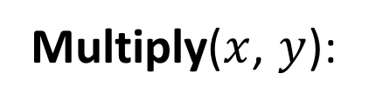
Divide and conquer algorithm not very precisely…
x,y are n-digit numbers
(Assume n is a power of 2…)
Multiply($x$, $y$):
Base case: I’ve memorized my 1-digit multiplication tables…
If n=1:
Return xy
Write $x=a {10}^{\frac{n}{2}}+b$
Write $y=c {10}^{\frac{n}{2}}+d$
Recursively compute $ac, ad,bc,bd$:
ac = Multiply(a, c), etc..
Add them up to get $xy$:
xy = ac 10^{n} + (ad + bc) 10^{n/2} + bd
a, b, c, d are
n/2-digit numbers
Make this pseudocode more detailed! How should we handle odd n? How should we implement “multiplication by 10^{n}”?
See the Lecture 1 Python notebook for actual code!
Siggi the Studious Stork

Slide 41
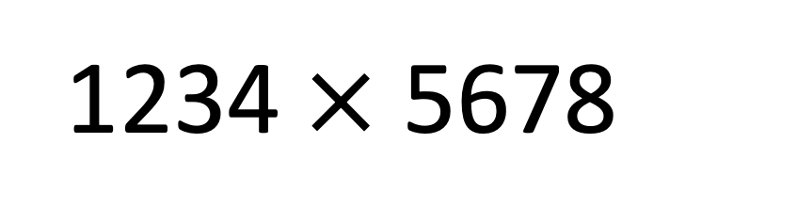
Think-Pair-Share
We saw that this 4-digit multiplication problem broke up into four 2-digit multiplication problems
If you recurse on those 2-digit multiplication problems, how many 1-digit multiplications do you end up with in total?
1234$×$5678

Slide 42
Recursion Tree
16 one-digit multiplies!
4 digits
2 digits
2 digits
2 digits
2 digits
1 digit
1 digit
1 digit
1 digit
1 digit
1 digit
1 digit
1 digit
1 digit
1 digit
1 digit
1 digit
1 digit
1 digit
1 digit
1 digit

Slide 43
What is the running time?
Better or worse than the grade school algorithm?
How do we answer this question?
Try it.
Try to understand it analytically.

Slide 44
1. Try it.
Check out the Lecture 1 IPython Notebook
Conjectures about running time?
Doesn’t look too good but hard to tell…
Maybe one implementation is slicker than the other?
Maybe if we were to run it to n=10000, things would look different.
Something funny is happening at powers of 2…

Slide 45
2. Try to understand the running time analytically
Proof by meta-reasoning:
It must be faster than the grade school algorithm, because we are learning it in an algorithms class.
Not sound logic!
Plucky the Pedantic Penguin

Slide 46
2. Try to understand the running time analytically
Think-Pair-Share:
We saw that multiplying 4-digit numbers resulted in 16 one-digit multiplications.
How about multiplying 8-digit numbers?
What do you think about n-digit numbers?

Slide 47
Recursion Tree
64 one-digit multiplies!
8 digits
4 digits
4 digits
4 digits
4 digits
2 digit
2 digit
2 digit
2 digit
2 digit
2 digit
2 digit
2 digit
2 digit
2 digit
2 digit
2 digit
2 digit
2 digit
2 digit
2 digit
1
1
1
1
1
1
1
1
1
1
1
1
1
1
1
1
1
1
1
1
1
1
1
1
1
1
1
1
1
1
1
1
1
1
1
1
1
1
1
1
1
1
1
1
1
1
1
1
1
1
1
1
1
1
1
1
1
1
1
1
1
1
1
1

Slide 48
2. Try to understand the running time analytically
Claim:
The running time of this algorithm is
AT LEAST n² operations.

Slide 49
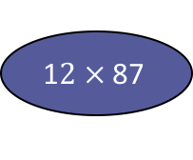
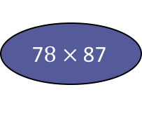
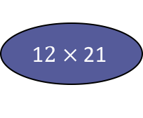
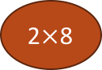
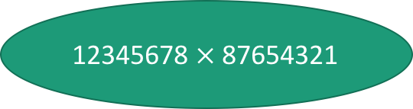
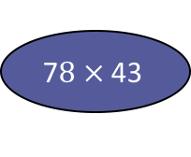
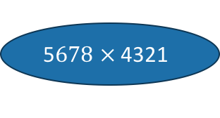
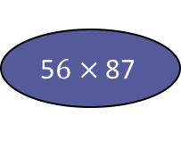
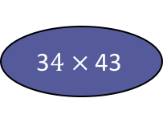
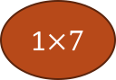
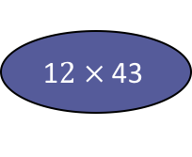
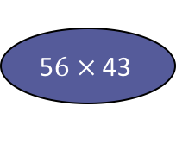
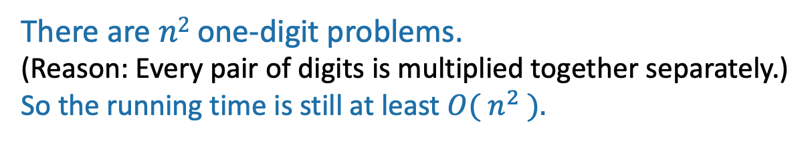
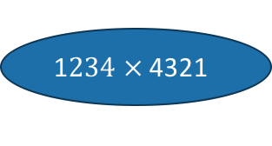
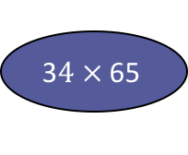
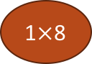
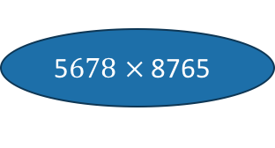
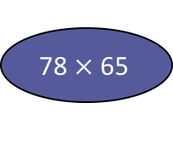
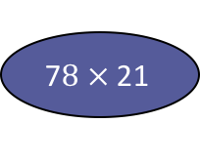
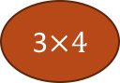
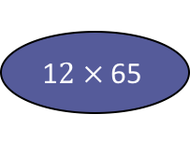
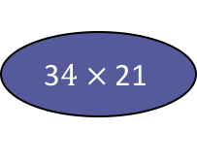
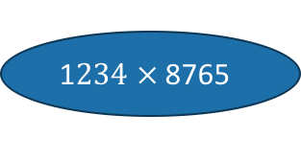
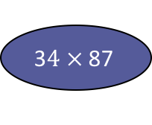
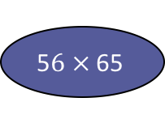

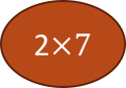
How many one-digit multiplies?
This slide skipped in class, here in case this view is more helpful for you.
12345678 $×$ 87654321
1$234 ×$ 8765
5$678 ×$ 8765
1$234 ×$ 4321
5$678 ×$ 4321
1$2 ×$ 87
5$6 ×$ 87
1$2 ×$ 43
5$6 ×$ 43
3$4 ×$ 87
7$8 ×$ 87
3$4 ×$ 43
7$8 ×$ 43
1$2 ×$ 65
5$6 ×$ 65
1$2 ×$ 21
5$6 ×$ 21
3$4 ×$ 65
78$×$ 65
3$4 ×$ 21
7$8 ×$ 21
…
3$×4$
…
1$×$8
1$×7$
2$×$8
There are $n2$ one-digit problems.
(Reason: Every pair of digits is multiplied together separately.)
So the running time is still at least ${O( n}^{2} ).$
2$×7$
etc...

Slide 50
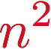
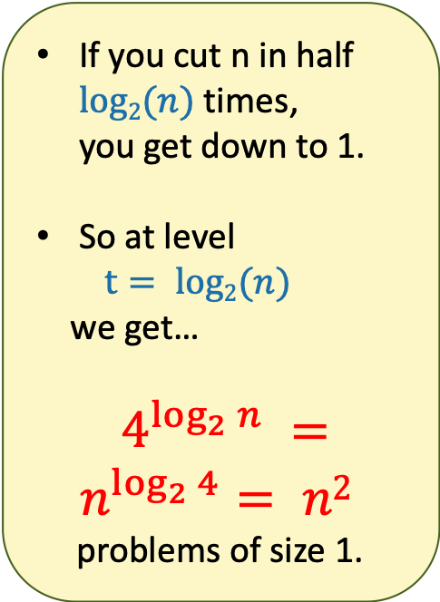
There are n² 1-digit problems
1 problem
of size n
If you cut n in half $log2(n)$times, you get down to 1.
So at level
$t= log2(n)$
we get…
$4^{\log_{2}{n}} =n^{\log_{2}{4}}= n2$
problems of size 1.
4 problems
of size n/2
…
4^{t} problems
of size n/2^{t}
Note: this is just a cartoon – I’m not going to draw all 4^{t} circles!
…
____ problems
of size 1

Slide 51

That’s a bit disappointing All that work and still (at least) $O\left(n^{2}\right)$…
$$n^{2}$$
But wait!!
$$n$$

Slide 52
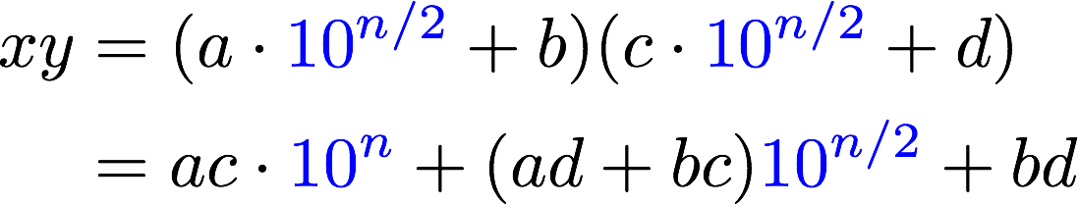
Divide and conquer can actually make progress
Karatsuba figured out how to do this better!
If only we could recurse on three things instead of four…
Need these three things

Slide 53
Karatsuba integer multiplication
Recursively compute these THREE things:
ac
bd
(a+b)(c+d)
Subtract these off
get this
(a+b)(c+d) = ac + bd + bc + ad
Assemble the product:

Slide 54
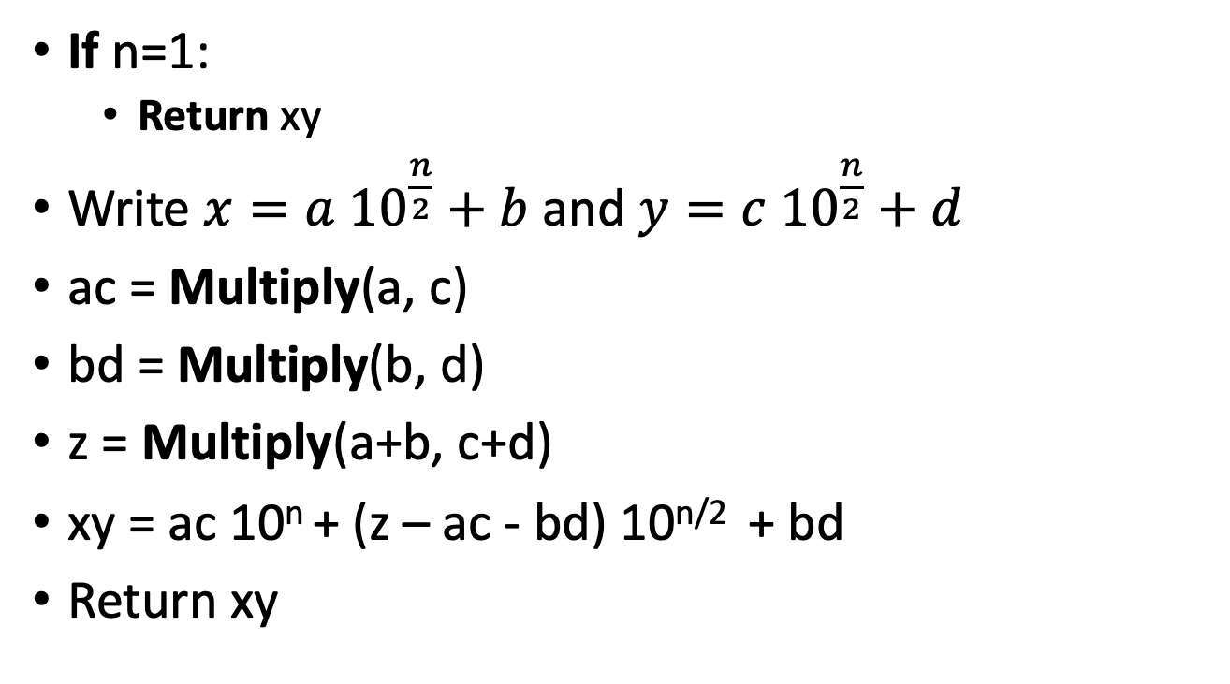
How would this work?
(Still not super precise, see IPython notebook for detailed code. Also, still assume n is a power of 2.)
x,y are n-digit numbers
Multiply($x$, $y$):
If n=1:
Return xy
Write $x=a {10}^{\frac{n}{2}}+b$ and $y=c {10}^{\frac{n}{2}}+d$
ac = Multiply(a, c)
bd = Multiply(b, d)
z = Multiply(a+b, c+d)
xy = ac 10^{n} + (z – ac - bd) 10^{n/2} + bd
Return xy
a, b, c, d are
n/2-digit numbers

Slide 55
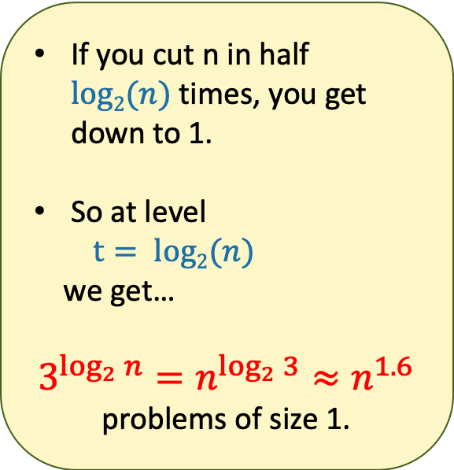
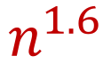
What’s the running time?
1 problem
of size n
If you cut n in half $log2(n)$times, you get down to 1.
So at level
$t= log2(n)$
we get…
$$3^{\log_{2}{n}}=n^{\log_{2}{3}}≈n^{1.6}$$
problems of size 1.
3 problems
of size n/2
…
3^{t} problems
of size n/2^{t}
Note: this is just a cartoon – I’m not going to draw all 3^{t} circles!
…
We aren’t accounting for the work at the higher levels! But we’ll see later that this turns out to be okay.
$$n^{1.6}$$
____ problems
of size 1

Slide 56
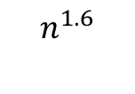
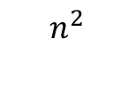
This is much better!
$$n^{2}$$
$$n^{1.6}$$
$$n$$

Slide 57
We can even see it in real life!

Slide 58
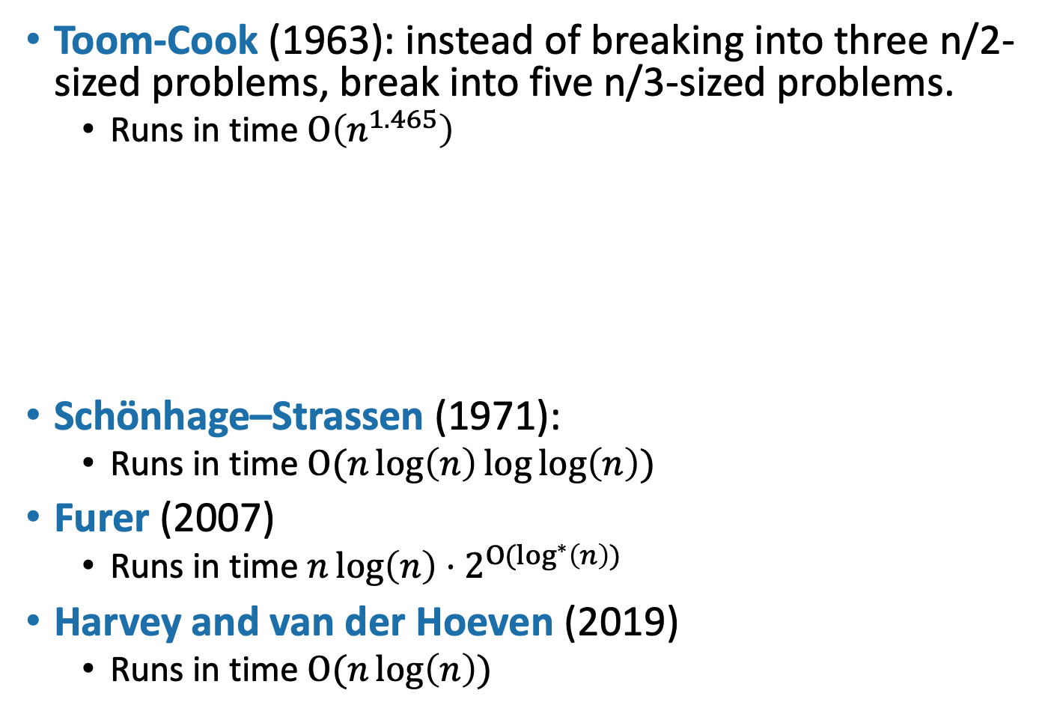
Can we do better?
Toom-Cook (1963): instead of breaking into three n/2-sized problems, break into five n/3-sized problems.
Runs in time $O\left(n^{1.465}\right)$
Schönhage–Strassen (1971):
Runs in time $O(n\log\left(n\right)\log{\log\left(n\right)) }$
Furer (2007)
Runs in time $n\log\left(n\right)⋅2^{{O(log}^{∗}\left(n\right)) }$
Harvey and van der Hoeven (2019)
Runs in time $O(n\log\left(n\right))$
Try to figure out how to break up an n-sized problem into five n/3-sized problems! (Hint: start with nine n/3-sized problems).
Given that you can break an n-sized problem into five n/3-sized problems, where does the 1.465 come from?
Siggi the Studious Stork
Ollie the Over-achieving Ostrich
[This is just for fun, you don’t need to know these algorithms!]

Slide 59
Today’s goals
Course goals
Think analytically about algorithms
Flesh out an “algorithmic toolkit”
Learn to communicate clearly about algorithms
Karatsuba Integer Multiplication
Algorithmic Technique:
Divide and conquer
Algorithmic Analysis tool:
Intro to asymptotic analysis

Slide 60
How was the pace today?

Slide 61
The big questions
Who are we?
Professor, TA’s, students?
Why are we here?
Why learn about algorithms?
What is going on?
What is this course about?
Logistics?
Can we multiply integers?
And can we do it quickly?
Wrap-up

Slide 62
Next time
Sorting!
Asymptotics and (formal) Big-Oh notation
Divide and Conquer some more
BEFORE Next time
Pre-lecture exercise! On the course website!

